Slide 1
Controllers and Actions
Chapter 16

Slide 2
Chapter Overview
Objectives
Understand the role of the controller
Write Actions to process requests
Chapter content
What is a controller?
Action and parameters
Returning Results from Actions
Passing data to views
Asynchronous Actions
Processing HTTP Forms
Exercise
Building controller classes

Slide 3

What is a controller?
A controller is a class with the following responsibilities:
Handle an incoming request
Respond to user input
Make changes to the model in response to user input
Work with inbound data
Provide outgoing data in the form of a View
Model
Orders
Request
Products
Controller
View
View
Response: html, xml, JSON, ..

Slide 4
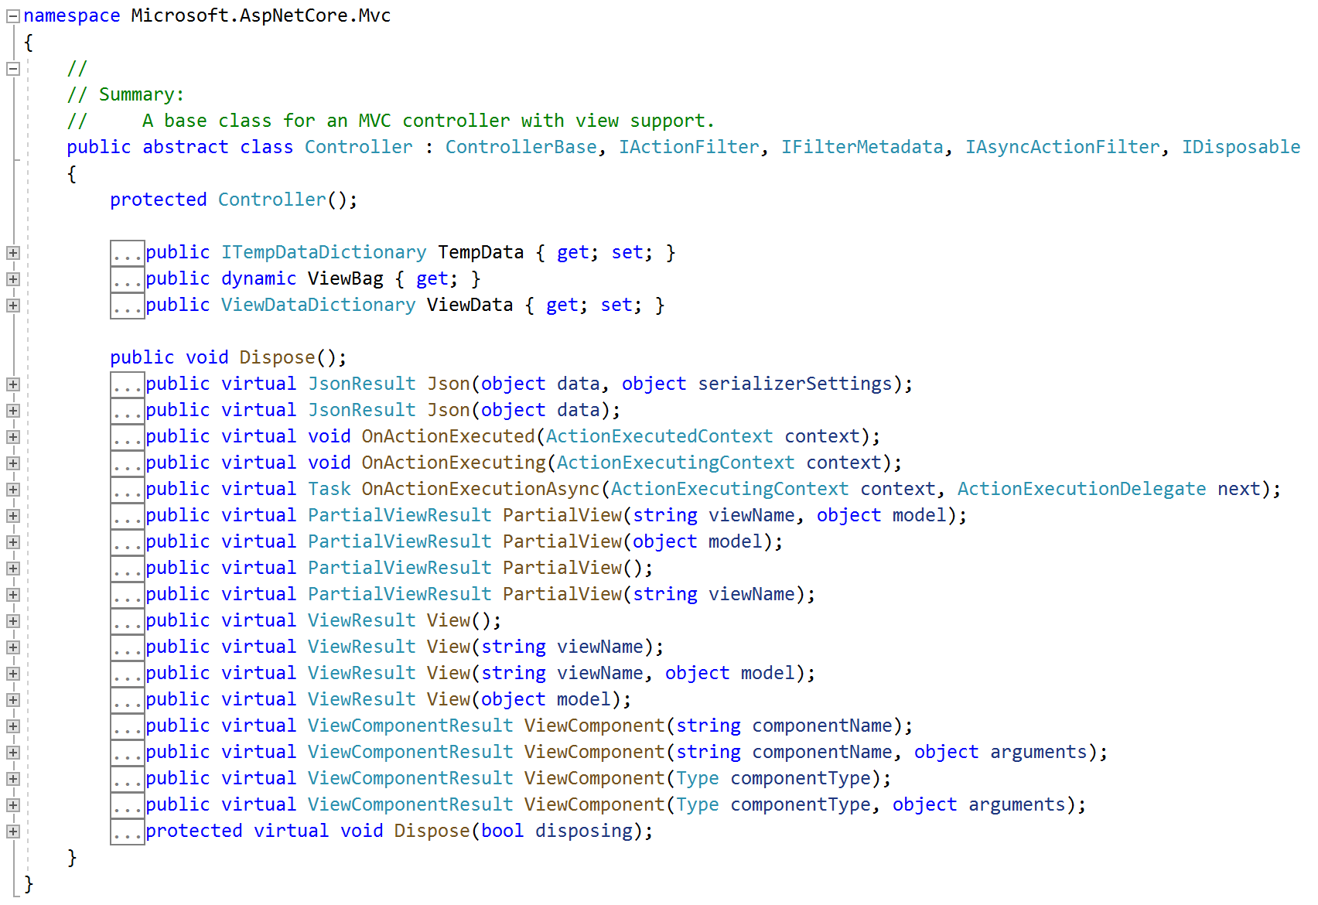
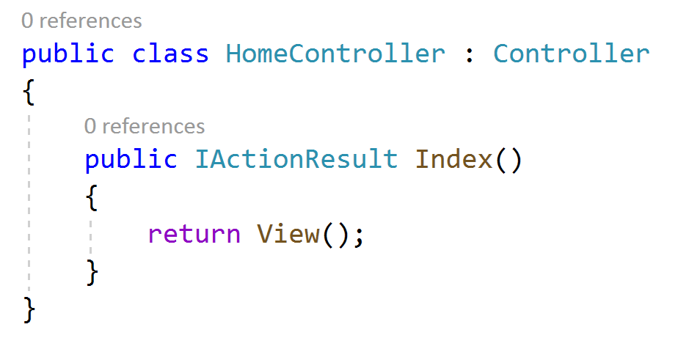
Implementing a Controller
To mark a class as a Controller, it is sufficient to simply suffix its name with “Controller”
E.g. HomeController, ForumController
It’s normal to inherit from the Controller class – gives access to a range of helper methods/properties
Some we’ve used:
View() and ViewBag
Notes:
All controllers must ultimately implement IController however, they usually inherit from either ControllerBase or Controller.
Both are abstract classes. ControllerBase implements IController directly and provides a rich API that includes properties such as ValidateRequest.
The Controller class actually inherits from ControllerBase and provides some additional behaviours such as ensuring that all public methods of the class are treated as actions.
Most controller classes inherit from the Controller class.

Slide 5
Controllers Contain Actions
Each inbound request is routed to a Controllers Action method
The Controllers Action methods contains the code which process the request
Routing
Controller
Request
Controller Factory
Action()
Action(arg1)
Model
Action(arg1, arg2)
Orders
Products
View
View
Response: html, xml, JSON, ..
Notes:
The controller is perhaps the most important class in your application.
As requests are received and routes determined, the MvcRouteHandler class chooses the most appropriate controller for that route.
Part of the route will specify the name of the controller that is to be used and another part of the route will specify the action.
Client requests are not for web pages. Rather, they are requests for a resource or an action to be carried out. When a controller’s action executes, it typically instantiates a model class and then passes into a view instance. The view is a file written in a format such as ASPX or Razor. A view engine then constructs the required HTML based upon the code in the view and the model data passed to it.
The resulting HTML (it needn’t be HTML) is then returned from the action and passed onto the client.

Slide 6
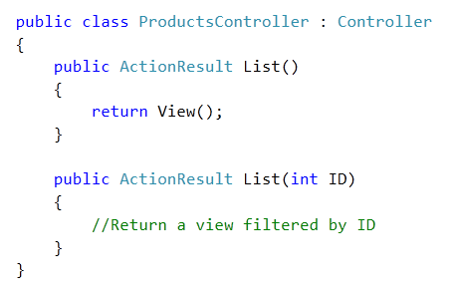
Action Methods
Action method can receive parameters
Action methods can be overloaded
Notes:
Actions are the endpoint of many requests and are analogous to both web page requests and web service method calls.
In both of those situations it is common to pass parameters. For example a web page might be requested with an accompanying query string:
www.qa.com/CourseDetail.aspx?Coursecode=QAANGULAR
It is believed that a route such as the following would be more search-engine friendly:
www.qa.com/CourseDetail/QAANGULAR
In fact both supplied sufficient information as most search engines read query strings.
However the following route is far more meaningful than it’s query string equivalent:
www.qa.com/courses/technical
www.qa.com/courses.aspx?id=7

Slide 7
Action Methods and Route Values
Arguments for action methods’ parameters are called Route Values
Can be passed as part of the URL
public class PersonController { public IActionResult Create(string name) {...} // http://.../Person/Create?name=Mary public IActionResult Create(string name, int age) {...} // http://.../Person/Create?name=Mary&age=51
Note how the arguments are passed using the standard HTTP query string format
Any parameters not listed on the query string will be set to their default
Null, 0, false, or similar
(This is a change from MVC Framework, which gives an error if no value is supplied for a non-nullable type)

Slide 8
Default parameters
Directly supported in the language
public class ProductController { public ActionResult List(int modelId, int categoryId = 1) {...} // http://.../Product/List/modelId=123 // Returns products in category 1
Notes:
Where parameters are concerned, you must be able to handle a situation where one or more parameters have been omitted.
Both VB.NET and C# support optional parameters where a default value is assigned to the parameter.
Note: Optional parameters have only been available in C# since version 4.0.

Slide 9
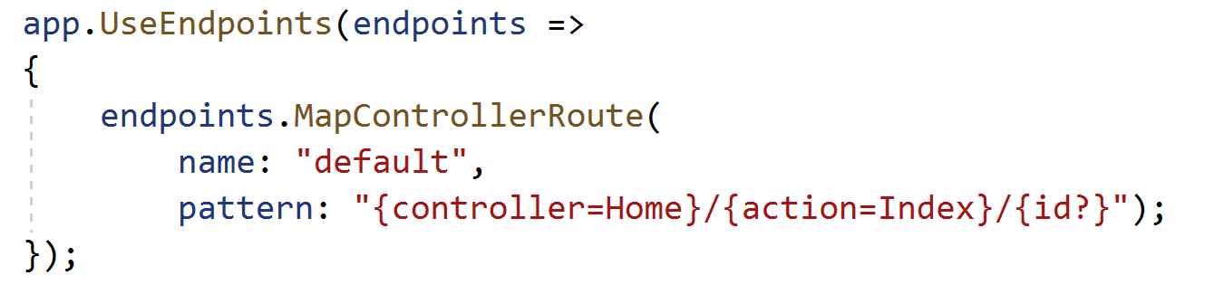
Action Methods and ID parameters
If an action method accepts a parameter called “id”, a different URL format is allowed:
public class PersonController { public ActionResult Get (int id) {...} // http://.../Person/Get?id=123 OR // http://.../Person/Get/123
This special URL format is allowed because of configuration set in Startup.cs:
This behaviour can be changed – we will investigate this in a later chapter

Slide 10
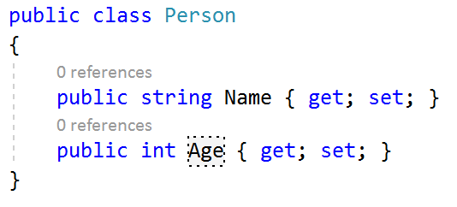
Action Methods with Complex Parameter Types
If an action takes a parameter whose type is a class
Each property in turn is matched to the route values
For this to work:
The class must have a parameterless constructor
The properties must have public setters
public ActionResult Create(Person person) {...} // http://.../Person/Create?name=Mary&age=51 // The “person” parameter will be set with Name=Mary, Age=51
This is called Model Binding

Slide 11
Specifying the Route Values
Route values can be entered into a form by the user
<form action="/Controller/Action" method="get"> <input type="text" name="paramName">
But often we want a link on a view to link directly to another action, including specifying route values
We can use helper methods to generate the links for us
There are many helper methods, which we will explore in a later chapter
But for now, here’s the helper method that we can use to give the user a link to another action:
@Html.ActionLink(linkText, actionName, controllerName, routeValues)
(Controller name and route values are both optional)
For example:
@Html.ActionLink("Click for details", "Details", new { id = 123 } )

Slide 12
The ActionResult
An Action returns a result, usually a view
You could code this:
Using the View helper method is simpler:
public IActionResult Index()
{
ViewData.Model = 42;
return new ViewResult {
ViewData = base.ViewData,
TempData = base.TempData,
ViewName = null
};
}
public IActionResult Index()
{
return View(42);
}
Notes:
Although there are times when an action returns no response, most of the time they do.
Actions are usually declared with a return type of ActionResult. This base type has many derivatives which are listed on the following page.
The action will then return an instance of the required result type.
Instead of you returning an instance of the required ActionResult type, these helper methods do that work for you:

Slide 13
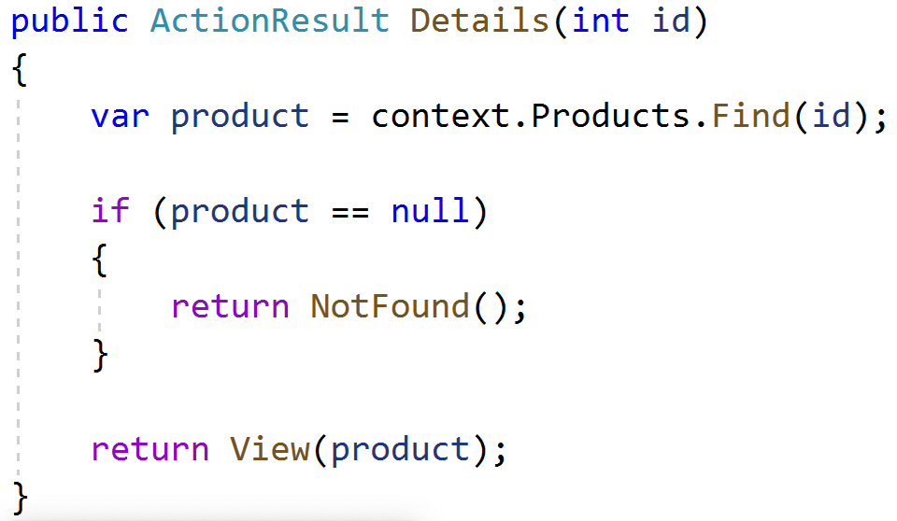
Action Methods Return Types
The ActionResult class is the base class for all action results
Action methods return an ActionResult
Or any type derived from ActionResult. Most result types have corresponding helper methods to generate them
ActionResult
EmptyResult
JsonResult
RedirectResult
NotFoundResult
ViewResult
FileResult
more...
Json()
Redirect()
NotFound()
View()
File()

Slide 14
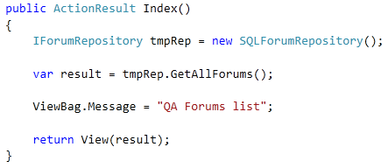
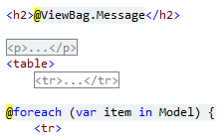
Passing Data to Views
Actions can pass data to views using several methods:
Model
Strongly typed, preferred method for complex data
ViewBag/ViewData
For simple adhoc data
Action
View
Notes:
You regularly need to pass data into views.
Typically this involves passing your model into the ActionResult helper such as View. Model data can be accessed in the view simply be referencing the Model object.
Sometimes, you want to pass additional data into a view.
MVC 3 saw the introduction of ViewBag which serves this purpose. ViewBag uses dynamic late binding to permit you to describe your data using properties rather than string keys.
Visual Studio 2015 is aware that the properties of ViewBag are dynamic and will therefore ignore them during compilation. Provided that the properties are there at run time, everything works perfectly.
Remember, the properties of ViewBag are dynamic so don’t expect any intellisense.

Slide 15
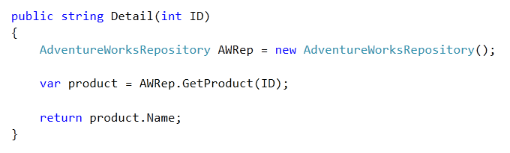
Implicit Action Results
You are not forced to return data as an ActionResult
Methods returning non-ActionResult types are implicitly returned as ContentResult
ContentResult requires a string. MVC will call ToString on the returned value.
Notes:
It is not necessary to return ActionResults from actions.
You may for example wish to return a double or int type. In this case, ASP.NET MVC will implicitly return a ContentResult initialised with a string representation of your return value.
In fact ASP.NET MVC calls ToString using the InvariantCulture on your return value and passes this into the ContentResult.

Slide 16
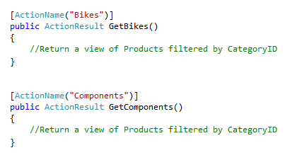
ActionName Attribute
Defines an Action name that differs from the method name
Allows Action names that conflict with C# rules
/Products/Bikes
Notes:
Where a number of methods can match a route, the ControllerActionInvoker can use ActionName attributes to identify the required action.
Although useful for scenarios where there may be a number of overloaded methods, the ActionName attribute has other applications.
Perhaps the developer has used a vocabulary for naming the actions that do not translate into good routes. E.g. GetBikes would be better represented by Bikes in the route.
Also, perhaps the design calls for nouns in the route that conflict with language rules. For example class, public, interface and page. It would be impossible to name your methods in that way. However, you could use the ActionName attribute to permit them in the route and then associate them with legal method names.

Slide 17
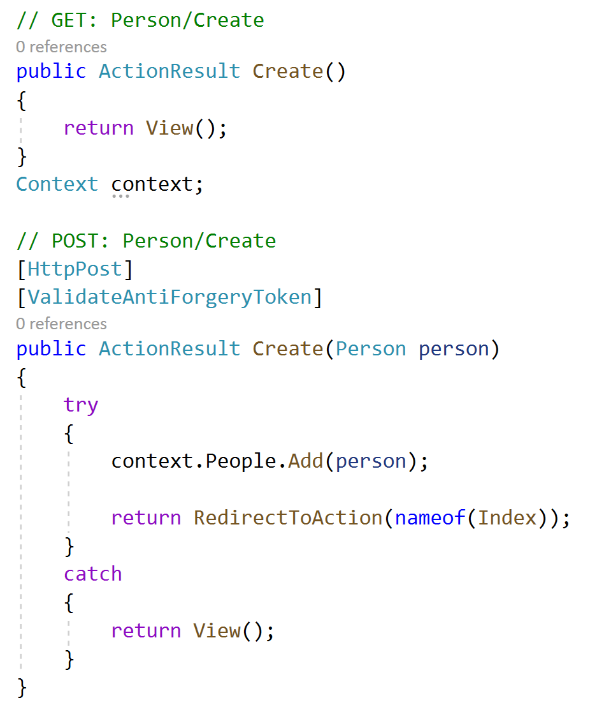
Get and Post Variants of an Action
Browser
Controller
GET /Person/Create
Empty create form
User populates
form
POST /Person/Create
......
data, data, data
Notes:
Here we have a 2-stage process
Return the empty form so the user can populate it
Submit the populated form
They are both “Create’s”
To make it easy we post back to the same Url – but we need a way of determining if we are requesting a blank form or offering a populated form to persist.

Slide 18
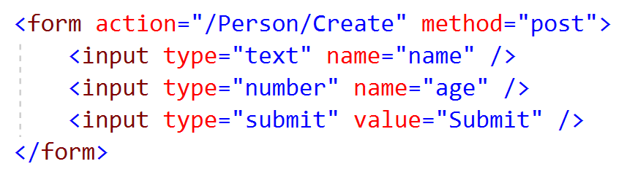
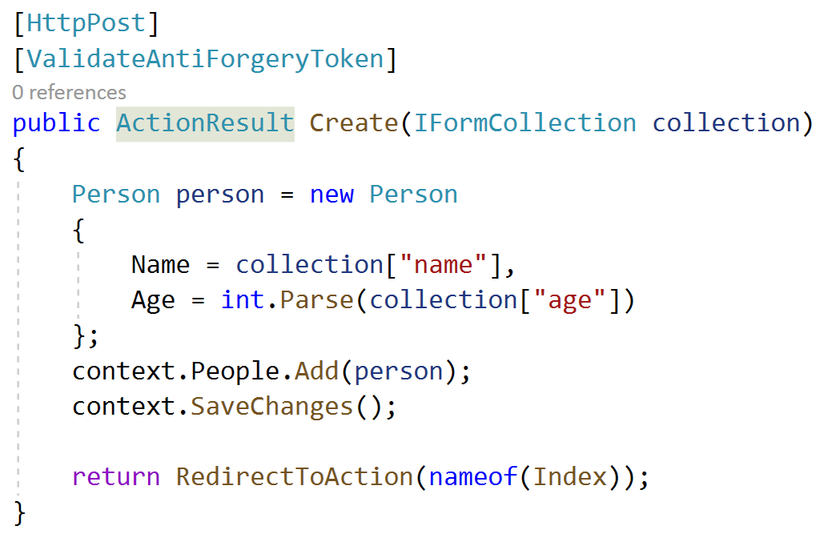
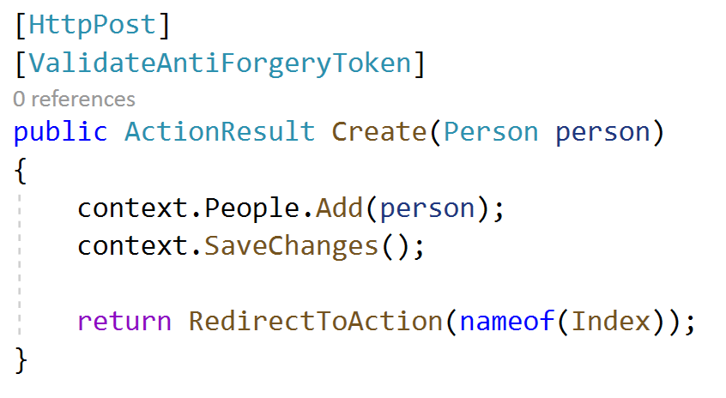
Processing HTTP Forms
Submitting HTTP Forms
The IFormCollection parameter type contains the data posted back to the server
Usually more convenient to replace this with parameter of the appropriate type and use Model Binding
Notes:
In an action where data is being posted back to the server, you frequently need to transfer the form data into an instance of the appropriate type.
e.g. If the view being posted back contains product data you would want to extract the data from the posted back form and place it into a Product object.
The default approach is to use the FormCollection parameter of such a method. E.g. Create or Edit. This parameter named form can be passed to the UpdateModel method along with an instance of the appropriate type. E.g. Product.
The UpdateModel method uses reflection to copy the data into the target object.
A more popular technique is to replace the FormCollection parameter with one of the target type. E.g. Product. This parameter will automatically be populated using the form data.
This technique is quicker and more readable.
FormCollection should still be used if the returning form contains any additional data that you wish to retrieve.

Slide 19
Async and Await Action methods
Asynchronous Actions are permitted
Cons.
Simple or short running operations
Simplicity and testability are important
Operations are CPU-bound rather than IO-bound
Pros
Testing shows that blocking operations are bottlenecking site performance
Parallelism is more important than simplicity of code
Operations are IO-bound rather than CPU-bound
Use for Action methods that call long running external processes:
Credit card validation
Web API Service calls
Database calls
Anything that can block
Notes:
When an action has to perform a long running process, not only does the client experience a delay in response, the action is holding onto a thread from the thread pool.
By writing asynchronous actions, threads can be returned to the thread pool during long running processes. E.g. Action is awaiting response from a web service.
When the action is ready to continue, it can reacquire a thread from the thread pool and continue.
The client process will see no improvement in response time. However, the application will permit greater throughput of requests because there is less blocking in the thread pool.

Slide 20
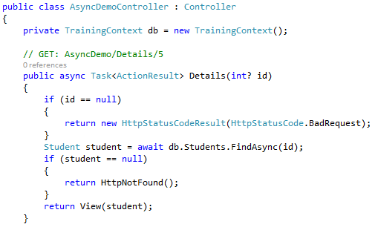
Asynchronous Controller Actions
To enable an async/await Action method
Mark Action method with the async keyword
Wrap the return type in Task<returntype>
Call long running methods asynchronously in method body
Use await keyword to pause execution and wait for results
Frees up the thread to be used elsewhere
Notes:
You can avoid performance bottlenecks and enhance the overall responsiveness of your application by using asynchronous programming. However, traditional techniques for writing asynchronous applications can be complicated, making them difficult to write, debug, and maintain.
Visual Studio 2012 introduced a simplified approach, async programming, that leverages asynchronous support in the .NET Framework 4.5 and the Windows Runtime. The compiler does the difficult work that the developer used to do, and your application retains a logical structure that resembles synchronous code. As a result, you get all the advantages of asynchronous programming with a fraction of the effort.

Slide 21
Chapter Review
Objectives
Understand the role of the controller
Write Actions to process requests
Chapter content
What is a controller?
Action and parameters
Returning Results from Actions
Passing data to views
Asynchronous Actions
Processing HTTP Forms
Exercise
Building controller classes
Notes:
Resources
http://www.w3schools.com/aspnet/mvc_controllers.asp

